Slide 1
Object Oriented Software Engineering (OOSE)
22CS017
White-Box Testing Techniques

Slide 2
Index
White-Box Testing Techniques:
Basis Path Testing,
Control Structure Testing: condition and loop testing,
Black-Box Testing Techniques:
Equivalence Partitioning and Boundary Value Analysis,
Testing Object Oriented Applications:
Testing OOA and OOD model, Object Oriented Testing Strategies, Object Oriented Testing Methods

Slide 3
White-Box Testing Techniques
a software testing technique that involves testing the internal structure and workings of a software application.
The tester has access to the source code and uses this knowledge to design test cases that can verify the correctness of the software at the code level.
Analyze the internal structures of the used data structures, internal design, code structure, and the working of the software rather than just the functionality as in black box testing.
also called glass box testing or clear box testing or structural testing.
also known as transparent testing or open box testing.
also known as structural testing or code-based testing, and it is used to test the software’s internal logic, flow, and structure.
The tester creates test cases to examine the code paths and logic flows to ensure they meet the specified requirements

Slide 4
White-Box Testing Techniques
Process of White Box Testing
Input: Requirements, Functional specifications, design documents, source code.
Processing: Performing risk analysis to guide through the entire process.
Proper test planning: Designing test cases to cover the entire code. Execute rinse-repeat until error-free software is reached. Also, the results are communicated.
Output: Preparing final report of the entire testing process.

Slide 5
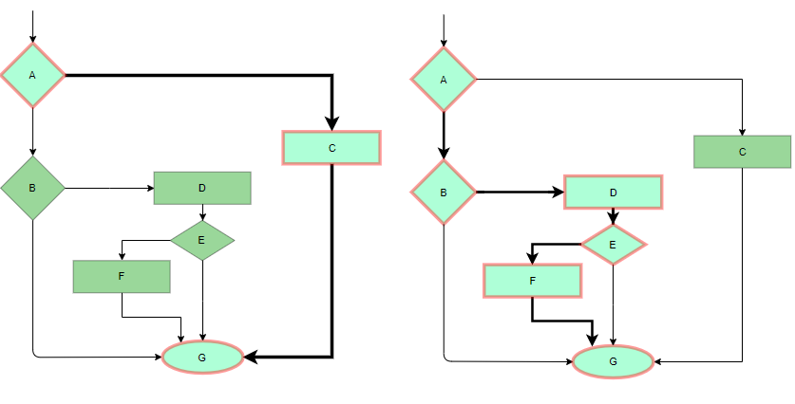
White-Box Testing Techniques
Testing Techniques
1. Statement Coverage
In this technique, the aim is to traverse all statements at least once. Hence, each line of code is tested. In the case of a flowchart, every node must be traversed at least once. Since all lines of code are covered, it helps in pointing out faulty code.
Figure 1: Statement Coverage Example

Slide 6
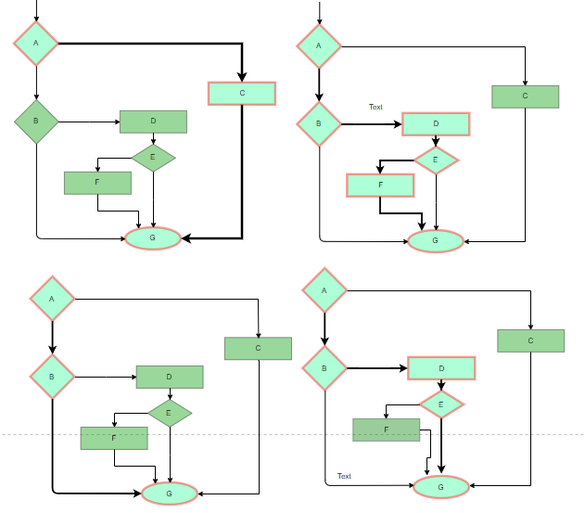
White-Box Testing Techniques
2. Branch Coverage:
In this technique, test cases are designed so that each branch from all decision points is traversed at least once. In a flowchart, all edges must be traversed at least once.
Figure 2: 4 test cases are required such that all branches of all decisions are covered, i.e, all edges of the flowchart are covered

Slide 7
White-Box Testing Techniques
3. Condition Coverage
In this technique, all individual conditions must be covered as shown in the following example:
READ X, Y
IF(X == 0 || Y == 0)
PRINT ‘0’
#TC1 – X = 0, Y = 55
#TC2 – X = 5, Y = 0

Slide 8
White-Box Testing Techniques
4. Multiple Condition Coverage
In this technique, all the possible combinations of the possible outcomes of conditions are tested at least once. Let’s consider the following example:
READ X, Y
IF(X == 0 || Y == 0)
PRINT ‘0’
#TC1: X = 0, Y = 0
#TC2: X = 0, Y = 5
#TC3: X = 55, Y = 0
#TC4: X = 55, Y = 5

Slide 9
White-Box Testing Techniques
5. Basis Path Testing
In this technique, control flow graphs are made from code or flowchart and then Cyclomatic complexity is calculated which defines the number of independent paths so that the minimal number of test cases can be designed for each independent path.
Steps:
Make the corresponding control flow graph
Calculate the cyclomatic complexity
Find the independent paths
Design test cases corresponding to each independent path
V(G) = P + 1, where P is the number of predicate nodes in the flow graph
V(G) = E – N + 2, where E is the number of edges and N is the total number of nodes
V(G) = Number of non-overlapping regions in the graph
#P1: 1 – 2 – 4 – 7 – 8
#P2: 1 – 2 – 3 – 5 – 7 – 8
#P3: 1 – 2 – 3 – 6 – 7 – 8
#P4: 1 – 2 – 4 – 7 – 1 – . . . – 7 – 8

Slide 10
White-Box Testing Techniques
6. Loop Testing
Loops are widely used and these are fundamental to many algorithms hence, their testing is very important. Errors often occur at the beginnings and ends of loops.
Simple loops: For simple loops of size n, test cases are designed that:
Skip the loop entirely
Only one pass through the loop
2 passes
m passes, where m < n
n-1 ans n+1 passes

Slide 11
White-Box Testing Techniques
6. Loop Testing (cont’d)
Nested loops:
For nested loops, all the loops are set to their minimum count, and we start from the innermost loop.
Simple loop tests are conducted for the innermost loop and this is worked outwards till all the loops have been tested.
Concatenated loops:
Independent loops, one after another. Simple loop tests are applied for each. If they’re not independent, treat them like nesting.

Slide 12
White-Box Testing Techniques
White Testing is performed in 2 Steps
Tester should understand the code well
Tester should write some code for test cases and execute them
Tools required for White box testing:
PyUnit
Sqlmap
Nmap
Parasoft Jtest
Nunit
VeraUnit
CppUnit
Bugzilla
Fiddler
JSUnit.net
OpenGrok
Wireshark
HP Fortify
CSUnit

Slide 13
White-Box Testing Techniques
Features of White box Testing
Code coverage analysis: White box testing helps to analyze the code coverage of an application, which helps to identify the areas of the code that are not being tested.
Access to the source code: White box testing requires access to the application’s source code, which makes it possible to test individual functions, methods, and modules.
Knowledge of programming languages: Testers performing white box testing must have knowledge of programming languages like Java, C++, Python, and PHP to understand the code structure and write tests.
Identifying logical errors: White box testing helps to identify logical errors in the code, such as infinite loops or incorrect conditional statements.
Integration testing: White box testing is useful for integration testing, as it allows testers to verify that the different components of an application are working together as expected.
Unit testing: White box testing is also used for unit testing, which involves testing individual units of code to ensure that they are working correctly.

Slide 14
White-Box Testing Techniques
Features of White box Testing
Optimization of code: White box testing can help to optimize the code by identifying any performance issues, redundant code, or other areas that can be improved.
Security testing: White box testing can also be used for security testing, as it allows testers to identify any vulnerabilities in the application’s code.
Verification of Design: It verifies that the software’s internal design is implemented in accordance with the designated design documents.
Check for Accurate Code: It verifies that the code operates in accordance with the guidelines and specifications.
Identifying Coding Mistakes: It finds and fix programming flaws in your code, including syntactic and logical errors.
Path Examination: It ensures that each possible path of code execution is explored and test various iterations of the code.
Determining the Dead Code: It finds and remove any code that isn’t used when the programme is running normally (dead code).

Slide 15
White-Box Testing Techniques
Advantages of Whitebox Testing
Thorough Testing: White box testing is thorough as the entire code and structures are tested.
Code Optimization: It results in the optimization of code removing errors and helps in removing extra lines of code.
Early Detection of Defects: It can start at an earlier stage as it doesn’t require any interface as in the case of black box testing.
Integration with SDLC: White box testing can be easily started in Software Development Life Cycle.
Detection of Complex Defects: Testers can identify defects that cannot be detected through other testing techniques.
Comprehensive Test Cases: Testers can create more comprehensive and effective test cases that cover all code paths.
Testers can ensure that the code meets coding standards and is optimized for performance.

Slide 16
White-Box Testing Techniques
Disadvantages of White box Testing
Programming Knowledge and Source Code Access: Testers need to have programming knowledge and access to the source code to perform tests.
Overemphasis on Internal Workings: Testers may focus too much on the internal workings of the software and may miss external issues.
Bias in Testing: Testers may have a biased view of the software since they are familiar with its internal workings.
Test Case Overhead: Redesigning code and rewriting code needs test cases to be written again.
Dependency on Tester Expertise: Testers are required to have in-depth knowledge of the code and programming language as opposed to black-box testing.
Inability to Detect Missing Functionalities: Missing functionalities cannot be detected as the code that exists is tested.
Increased Production Errors: High chances of errors in production.

Slide 17
Practice Questions
Q1. What are the various Testing Levels? a) Unit Testing b) System Testing c) Integration Testing d) All of the above Answer: d
Q2. Which of the following testing is also known as white-box testing?
Structural testing
Error guessing technique
Design based testing
None of the above
Answer: a
Q3. The white box testing can be proceeded after --------- phase?
coding phase
designing phase
SRS creation
installation phase
Answer: a

Slide 18
Bibliography
https://www.javatpoint.com/white-box-testing
https://www.tutorialspoint.com/software_testing_dictionary/white_box_testing.htm
https://www.softwaretestinghelp.com/white-box-testing-techniques-with-example/
https://www.softwaretestinghelp.com/types-of-software-testing/
https://www.tutorialspoint.com/software_engineering/software_design_strategies.htm
https://www.softwaretestinghelp.com/types-of-software-testing/
https://www.tutorialspoint.com/software_testing_dictionary/alpha_testing.htm
https://www.tutorialspoint.com/software_testing_dictionary/validation_testing.htm
https://www.tutorialspoint.com/software_testing_dictionary/acceptance_testing.htm

Slide 19
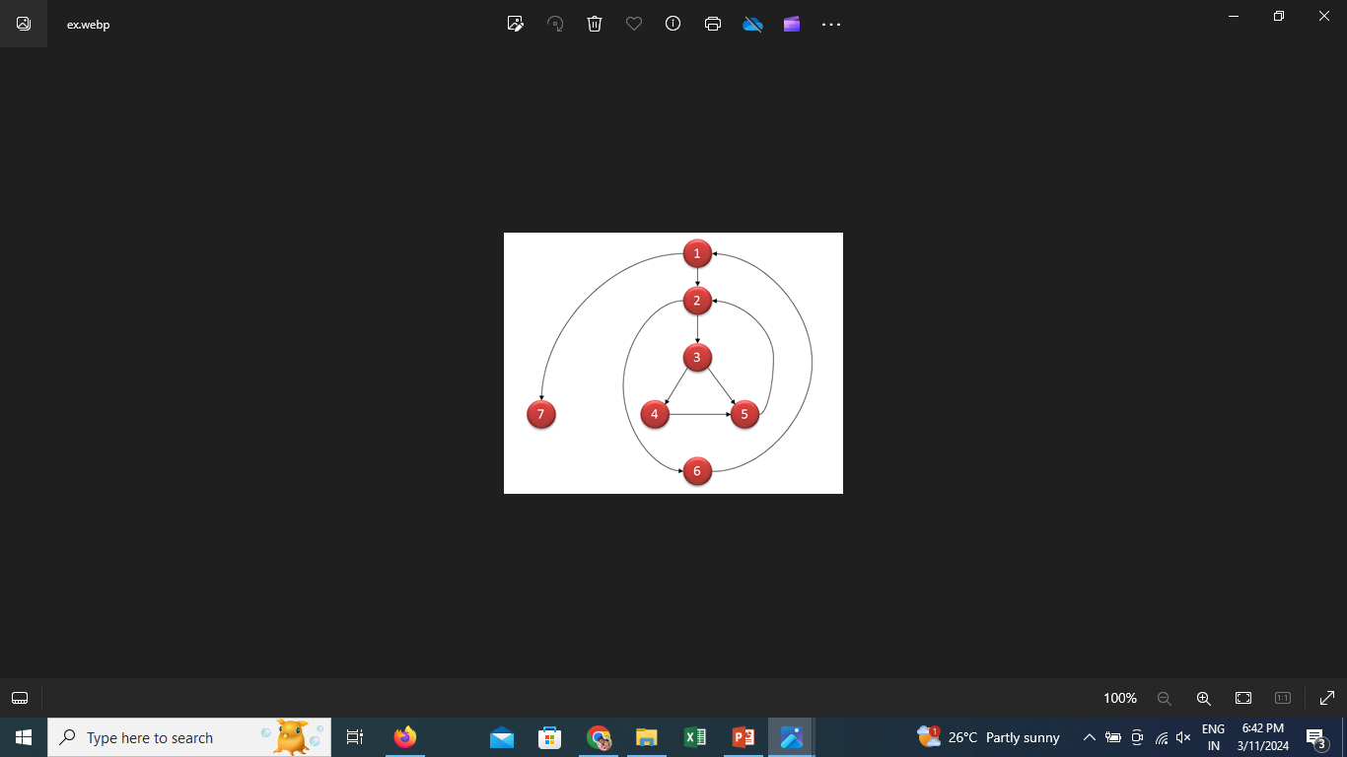
Example: Cyclomatic complexity

Slide 20
Calculation:
V(G) = E - N + 2=9-7+2=4
V (G) = P + 1=3+1=4
V(G)=REGION=4

Slide 21
Computing mathematically,
V(G) = 9 – 7 + 2 = 4
V(G) = 3 + 1 = 4 (Condition nodes are 1,2 and 3 nodes)
Basis Set – A set of possible execution path of a program
1, 7
1, 2, 6, 1, 7
1, 2, 3, 4, 5, 2, 6, 1, 7
1, 2, 3, 5, 2, 6, 1, 7

Slide 22
THANK YOU

